Slide 1
A Lap Around Visual Studio Team System 2010
Jim Blizzard, MCSD for .NET
Jim.Blizzard@Microsoft.com
http://jimblizzard.spaces.live.com
Notes:
The video from this session can be found at http://channel9.msdn.com/pdc2008/TL47

Slide 2
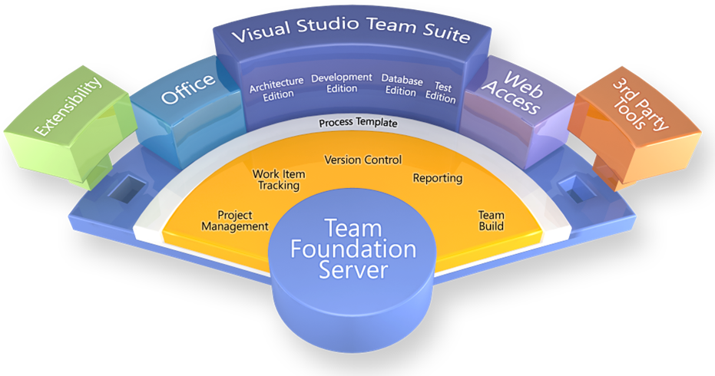
Team System 2008

Slide 3
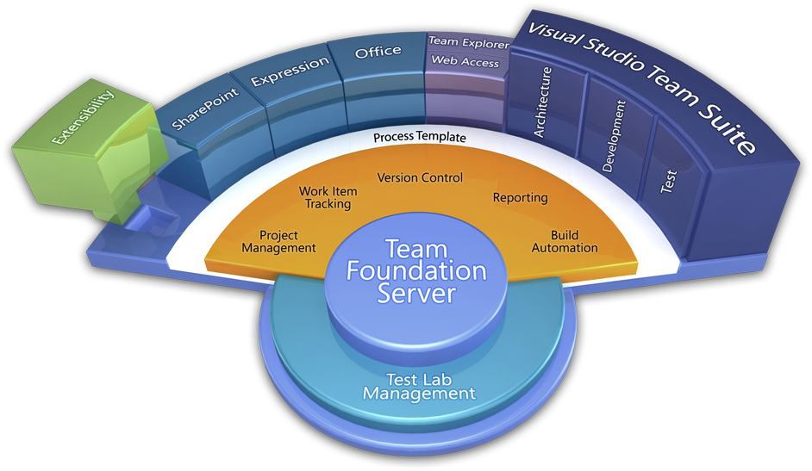
Team System 2010

Slide 4
VSTS 2010 Goals
Align IT with the Business
Enable quality with great tools
Architecture tools for everyone
Notes:
Business Alignment:
-Build the right thing
-Track and Manage It
-Report
-Manage change

Slide 5
Core QUALITY themes
No more “no repro”
No more broken builds
No more “butterfly effect”
No more regressions

Slide 6
Some of the new features
Architecture Explorer
UML Modeling
Testing enhancements
Camano
Manual test runner
Coded UI test generation
Test impact viewer
Enhanced version control
Gated check-in
Branch visualization
Build workflow

Slide 7
New Modeling Tools
New Architecture Explorer
Explore existing code assets visually
Layer Diagram
Visualize the intended architecture
Validate code against the diagram
UML support
Use case, activity, and sequence diagrams
Top Down
Create new apps using models
Bottom Up
Model can assist in understand existing apps

Slide 8
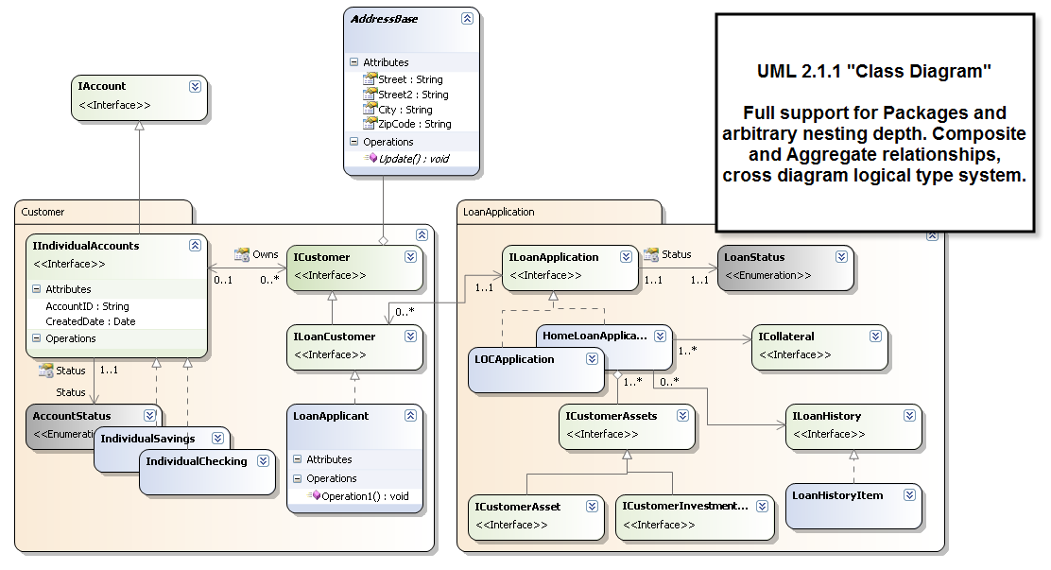
UML: Logical Class Diagram

Slide 9
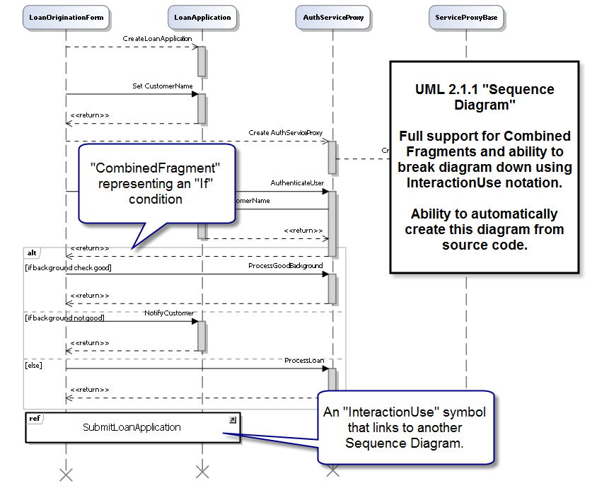
UML Sequence Diagram

Slide 10
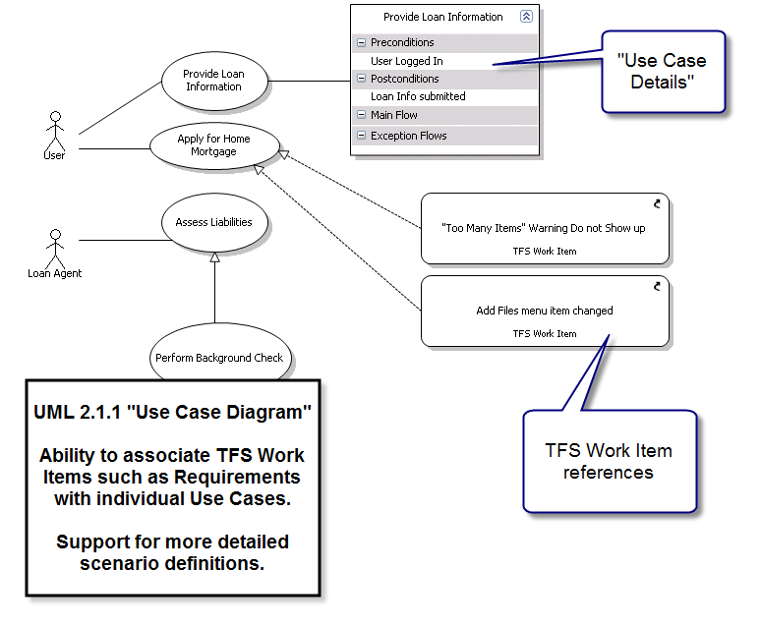
UML Use Case Diagrams

Slide 11
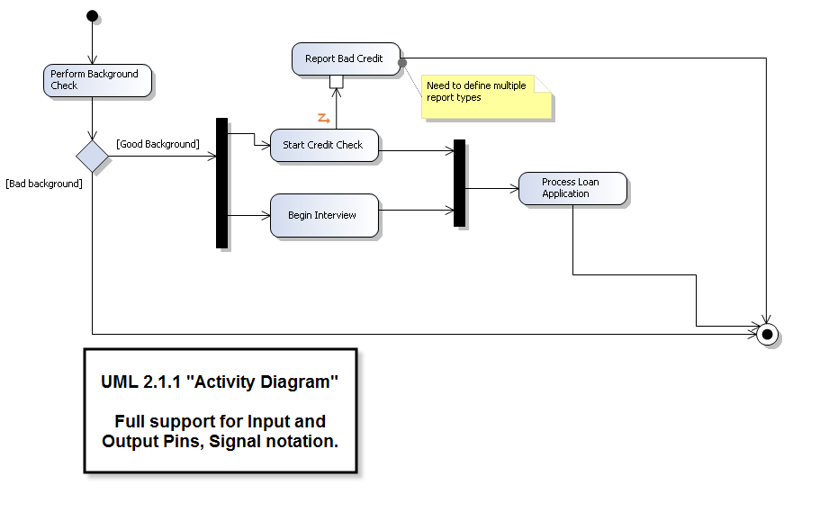
UML Activity Diagrams

Slide 12
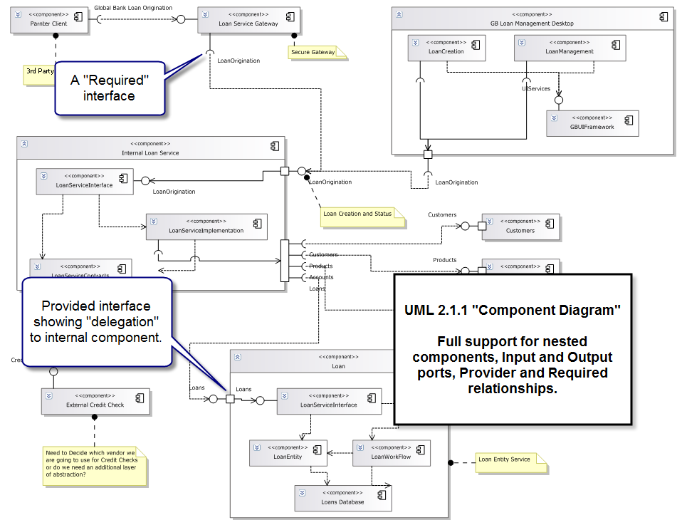
UML Component Diagram

Slide 13
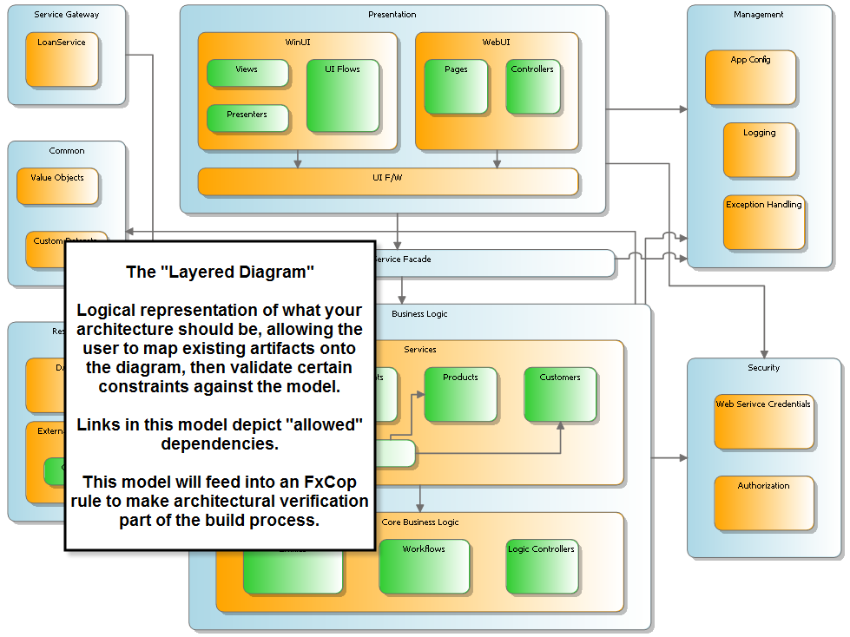
Architectural Validation Through Layer Diagram

Slide 14
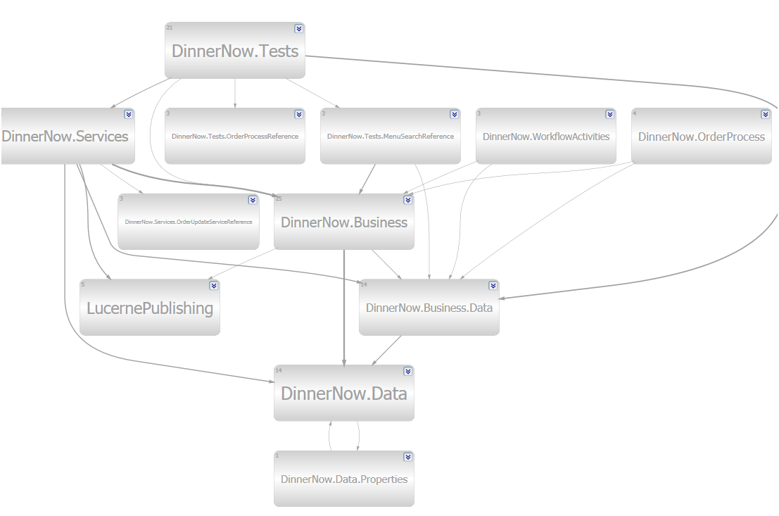
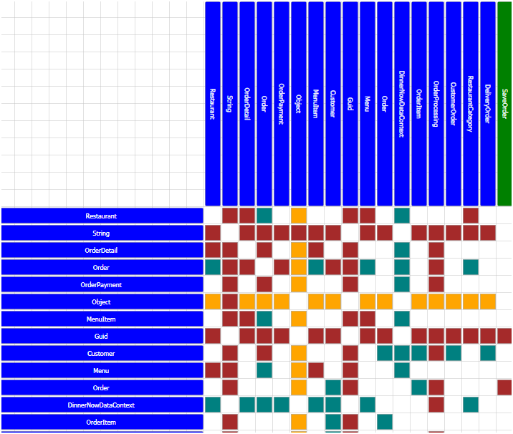
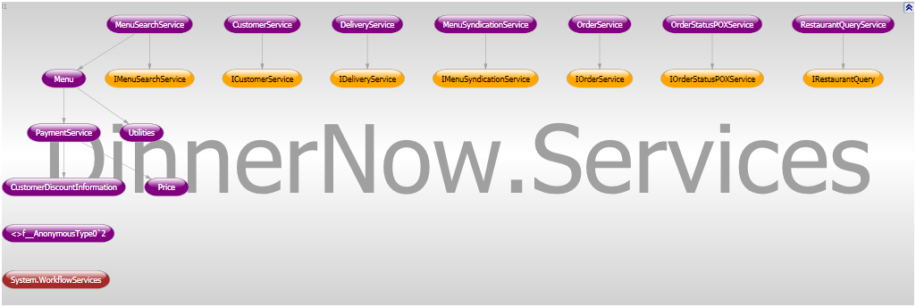
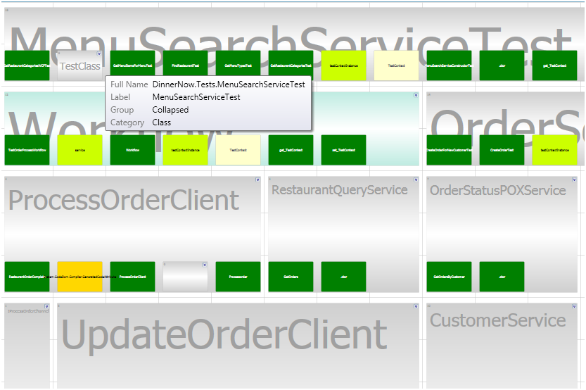
Dependencies
Discover relationships between namespaces, classes, assemblies.
Understand existing code.
Detect anomalies.
Notes:
Dependency matrix: colors indicate whether object inherit, references, calls, etc.

Slide 15
Improving Application Quality
VSTS 2010 Development & Database Editions are merged into combined Development Edition.
Significant improvements to Test Edition
Reduce barriers between dev + test.
Catch defects as early and easily as possible.

Slide 16
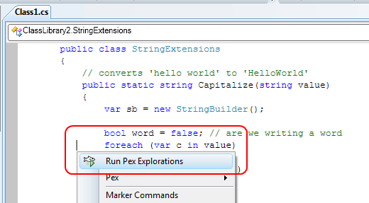
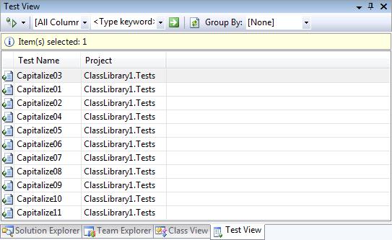
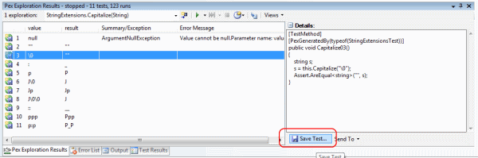
"PEX": Automated White Box Testing for .NET
Produces a traditional unit test suite with high code coverage.
Pex learns the program behavior by monitoring execution traces.
Notes:
PEX may ship with VSTS 2010 or as a Powertool post release.

Slide 17
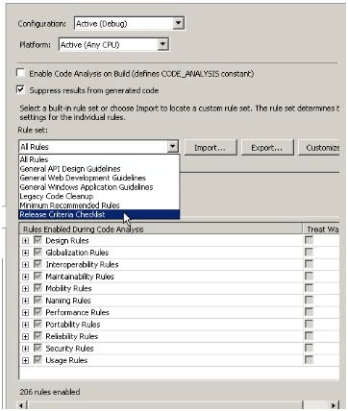
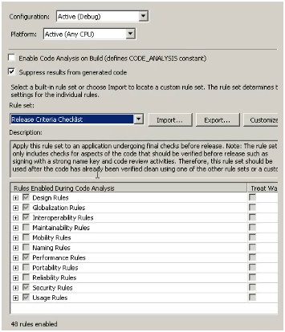
Code Analysis
More rules
Reduce “noise” via Rulesets
Notes:
Rulesets are customizable.

Slide 18
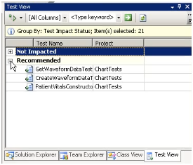
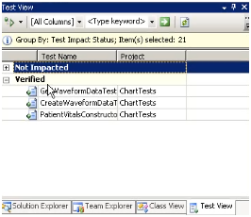
Test Impact Analysis
Given 100s or 1000s of automated tests, which tests should be run when code is changed?
Running all test could be time consuming.
Save time, speeds development/testing by using TIA.

Slide 19
Eliminate “No-repro” Bugs
Write Code
Hand-off to Test
Test Code
File Bug
Hand-off to Dev
Verify Bug
Resolve as
“No Repro”
Notes:
From the design of the application through to the actual writing of the code, one of the most difficult problems has always been that of the bug that can’t be reproduced – the “no-repro” bug. There are a lot of factors that drive these types of bugs and we have worked to create tools to help isolate the issue and enable faster fixes. One way this is solved in Visual Studio Team System 2010 is with the use of a tool that can specify the exact state of the build used by a tester and allow a comparison to the state of the build used by the developer when trying to reproduce the bug. It is often the subtle differences between these two that create the no-repro state, and a new tool within Visual Studio Team System 2010 has been designed to specifically address this.
This tool – the Microsoft Test Runner – is a standalone tool that a tester uses to guide them through a series of steps to complete a test case. When the test case is started the Microsoft Test Runner takes a snapshot of the system data, including OS version and Service Pack and other pertinent system data. As the test is being run the tester can use the tool to capture images of the application under test, or even partial or full screen video of the test being run. If an issue is discovered, the tester can create a new bug in Team Foundation Server and attach these artifacts. When attached, the screen capture video is fully indexed with the test steps as bookmarks, making it easier for the developer to see what went wrong on the tester’s machine. All of these artifacts help to eliminate the no-repro scenario, and help build a better bridge between development and test.

Slide 20
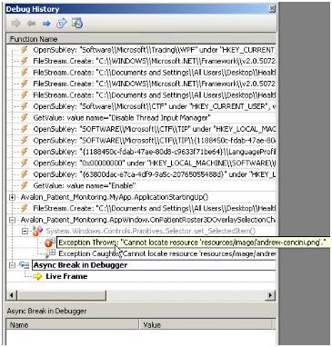
Historical Debugger
Captures full application lifetime stack and events.
When a defect occurs, step back in time to find the cause. Time machine for your apps.
Captures exceptions, registry/file-system calls.
Easier than breakpoint centered debugging.
Debug log can be attached to TFS Bug WI.
Notes:
Can record entire application lifetime or just portions of the lifetime.

Slide 21


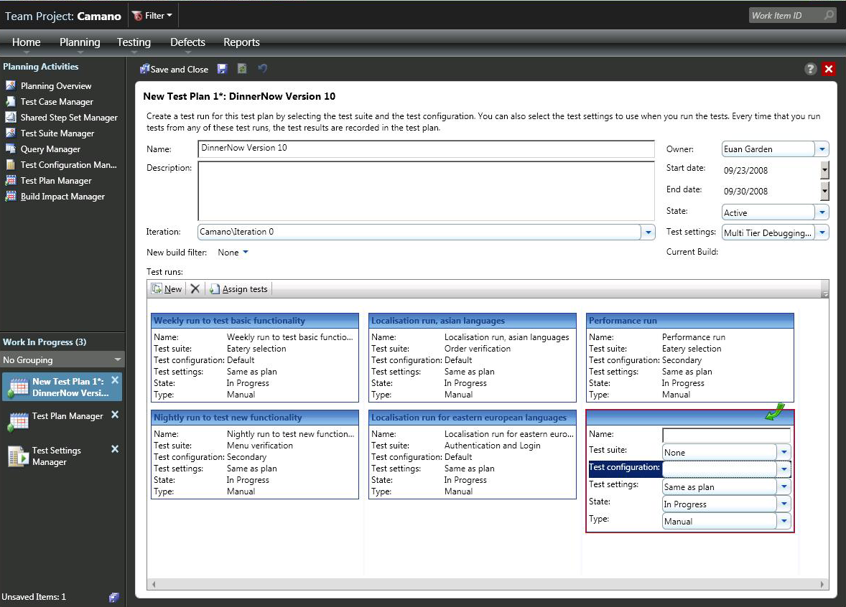
Test Case Management
Codename “Camano”
Lightweight, VS not required
Compose test cases, plans and suites.
Integration with TFS
Can record & playback
Link test cases to requirements, user stories, etc.

Slide 22
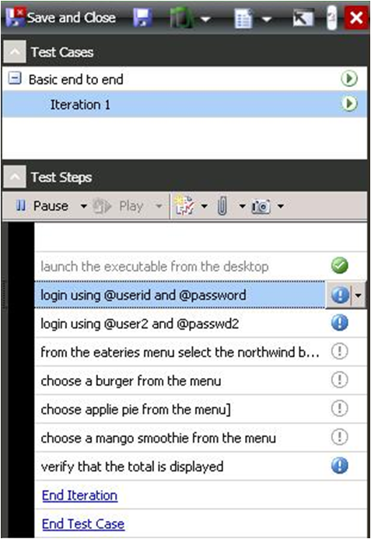
Manual Test Runner
Lightweight tool
Enables execution of test cases
Manual and automated test support
Collects system data and event log
Captures still images and video
Enables filing a new bug

Slide 23
Virtual Test Lab
Easily provision (create & configure) a clean test environment.
Can be a single or multiple virtual machines.
Can represent testing, staging or other environments.
Repeatable and reusable environment.
Easily deploy and test your application.
Built in workflow.
Deploy output of Team Build to VTL.
Integrates with Manual Test Runner.
Checkpoint: Can capture VM state in case of error and link to bug report.
Dev instantiated VM at checkpoint to investigate bug.
Notes:
-Checkpoints: captures VM state at time of error
-Network Fencing: enables many VMs with the same DNS name to be used at the same time.

Slide 24
Team Foundation Server 2010
Provides software engineering infrastructure: source control, work item tracking, build management, PM, collaboration.
Major improvements
Setup, Administration, Management
Version Control
Project Management
Performance & Scalability
Notes:
Version control & parallel development - One of the challenges people face today is how to manage parallel development more simply. In VSTS 2010 we are providing a bunch of capabilities to better manage parallel development. These include exposing Branch as a primary entity in our object model allowing you to include meta-data like owner, purpose, etc to each branch. We’re also introducing some new UI to visualize the flow of checkins and work items between branches. Finally, we’ve made improvements in merging, conflict resolution and history that help make managing parallel development and sophisticated release processes easier.
Operations & Administration of TFS - We've done more work to simplify and make TFS setup more easier. We've also increased the TFS topologies we support. We've added a new MMC based administration console that makes configuration changes MUCH easier. We've enable network load balancing for transparent resiliency and enabled Team Projects to be scaled out across databases for easier load balancing, improved isolation and better manageability.
Improvements to automated build - In addition to the gated checkin mentioned above, VSTS 2010 includes a new Windows Workflow Foundation based build engine that enables better extensibility to manage the entire build process. It makes it easy to parallelize a build across multiple machines. VSTS 2010 also introduces the notion of "build agent" pooling so that a farm of build machines can process builds simultaneously rather than processing one build at a time.

Slide 25
TFS 2010: Setup & Administration
Enterprise TFS
App Tier load balancing
DB partitioning
Multi Tenant & Isolation
Lightweight TFS
SharePoint & RS optional
Good for teams that need VC, WIT, Build
TFS Projects
Move between servers
Archive/Restore
MMC based TFS Administration Tool
TSWA in the box

Slide 26
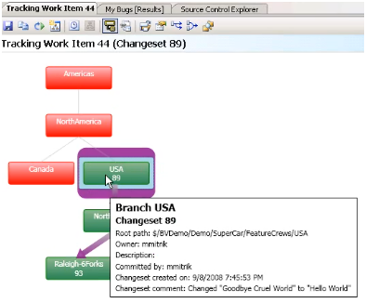
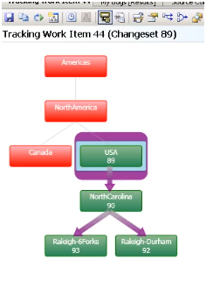
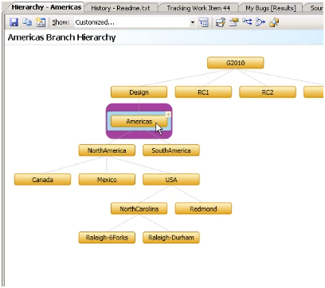
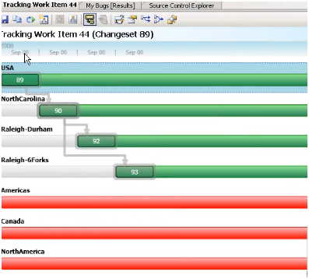
TFS 2010: Version Control
Track Work Item
Where in the code base has a feature, bug fix, requirement, etc flowed into? When did it happen?
Branch Visualization
What does my source tree look like?
Visualize branches, merges.
Drag & drop merge

Slide 27
Plan and Manage the Work
Hierarchal Work Items
Improved Excel-based Agile planning tools
High fidelity integration with Microsoft Project Server
Cross project dashboard and reporting
Simpler reporting
Notes:
Work item tracking improvements, including support for work breakdown hierarchies and customizable link types that allow queries which include the relationships between different types of work. For example, you’ll be able to query for all requirements linked to a particular test.
New project scheduling features that enable better coordination between project management and the rest of the organization. The 2010 release includes dedicated integration with Project Server for enterprise wide project management. Additionally you can expect new features for
Agile project including more integration with Excel.
Dashboards and cross project reports that provide roll up of status across diverse projects with drill down capabilities to investigate hot spots in the data.
A simplified data warehouse and reporting experience that makes it easier to build custom reports that fit exactly the questions you want to answer.

Slide 28
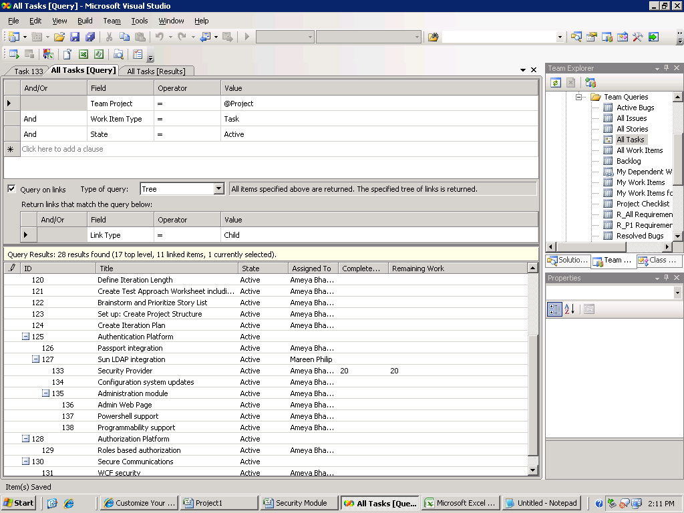
80
80
40
40
40
40
20
20

Slide 29
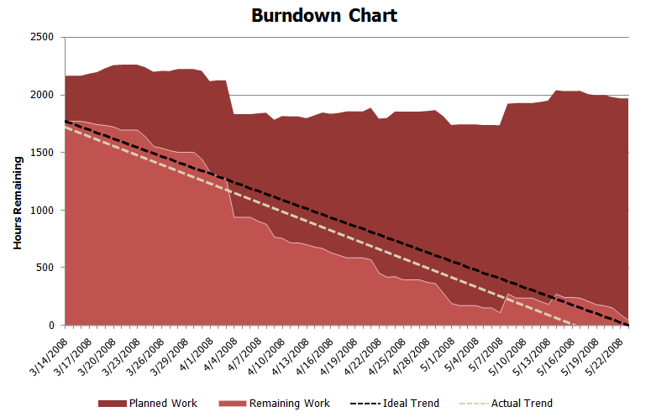
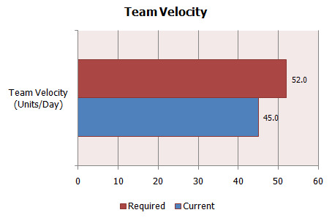
Plan and Manage the Work

Slide 30
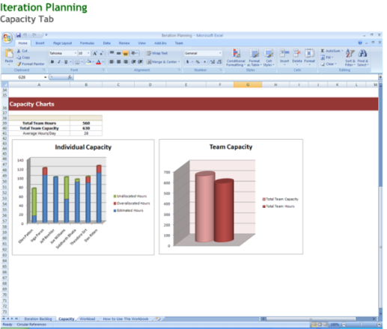
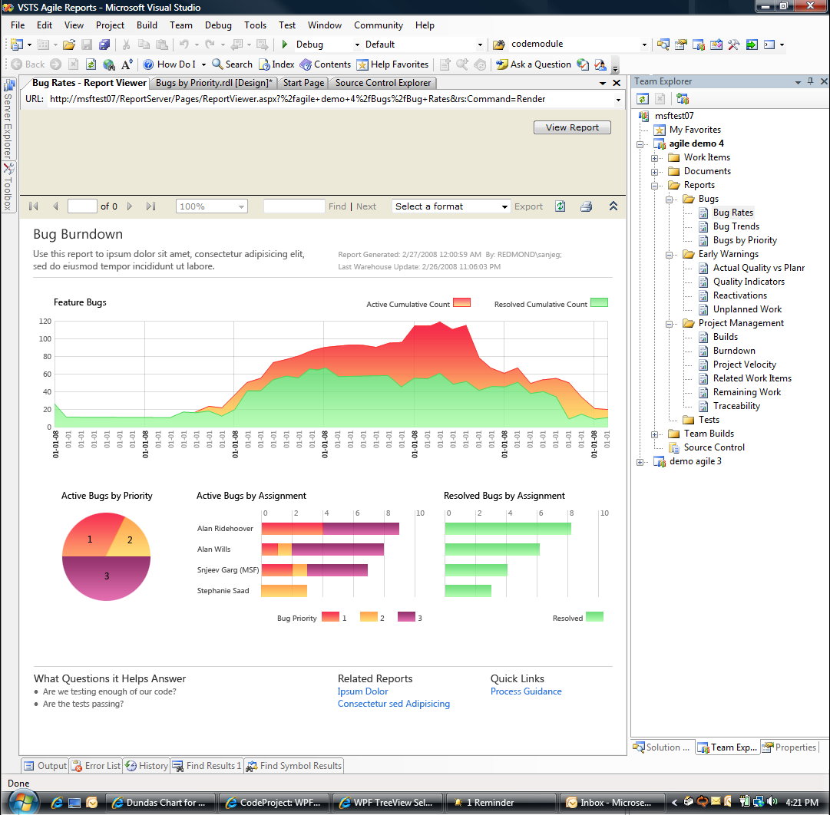
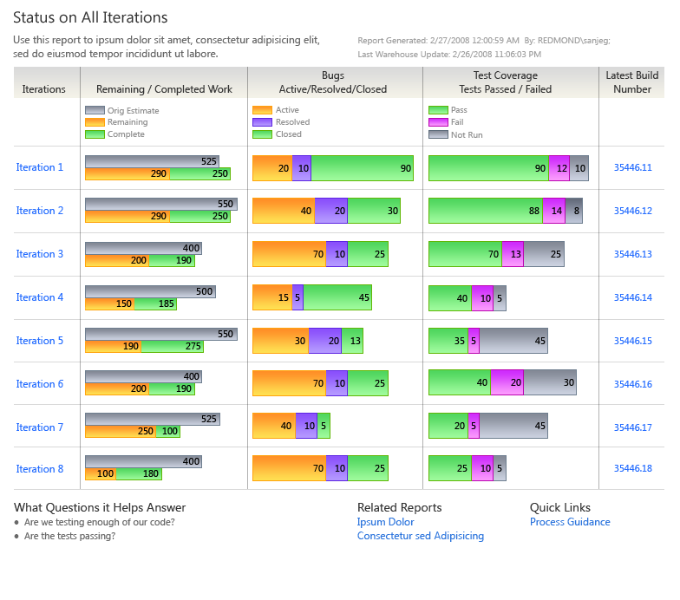
Reports

Slide 31
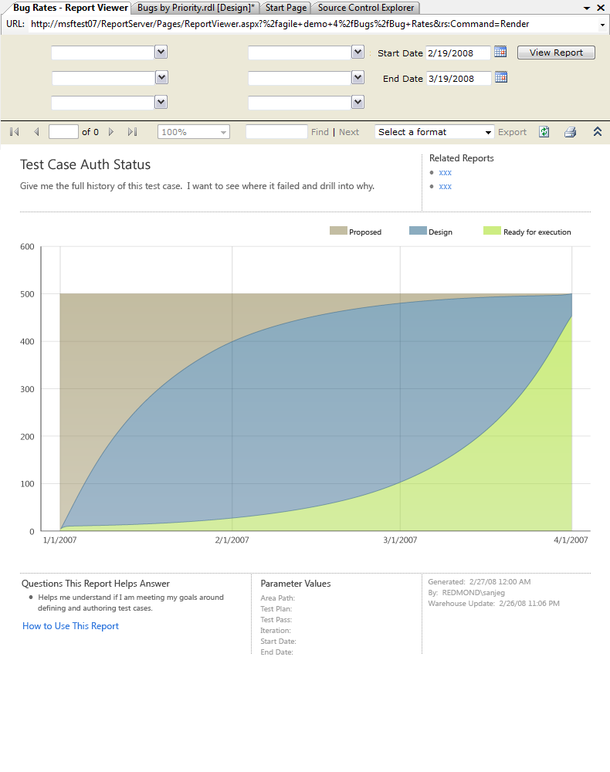
TFS Reports

Slide 32
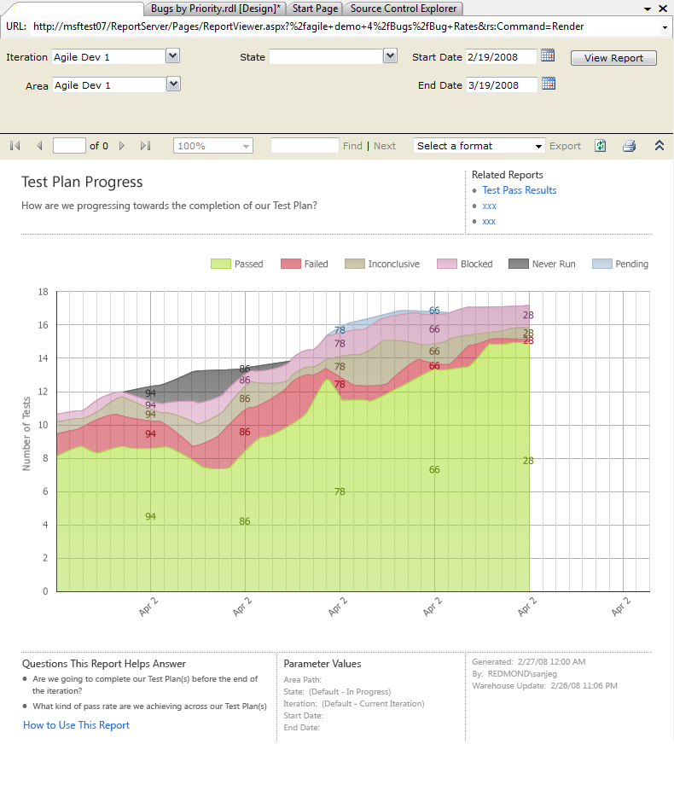
TFS Reports

Slide 33
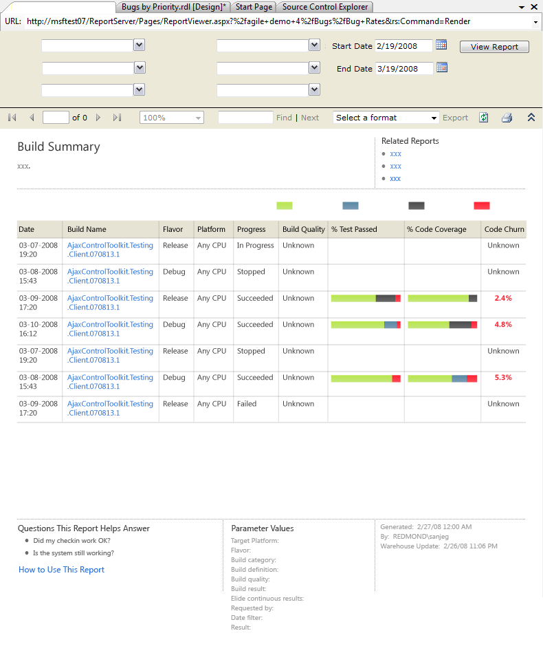
TFS Reports

Slide 34
Enterprise Project Management
Can synchronize TFS work items with Project desktop and Project Server.
Full fidelity synchronization via hierarchical work items.
Devs can update work items.
Status, hour worked/remaining, etc
Information will flow into project plan
PMs can focus on higher level project management, less on tracking.
Project Server can assist with resource management, budgeting, etc.

Slide 35
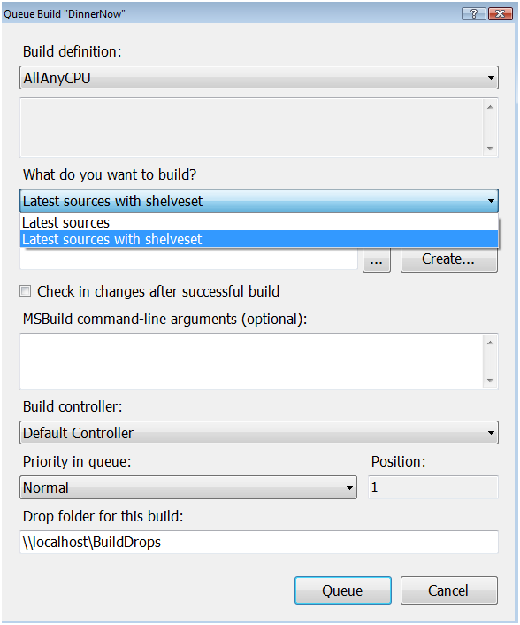
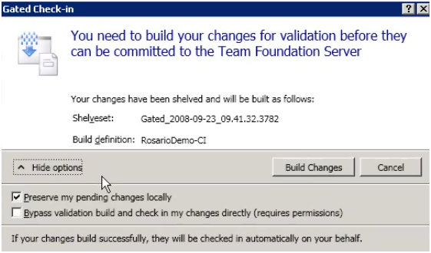
TFS Build Management
Distributed build
1:Many or Many:Many builds:agents
Build Agent Pooling
Best available agent will be selected
“Tagged” agents can be selected
i.e. build server for BizTalk components
Build notifications
Layer Diagram Validation
Gated check-in
Shelveset/Buddy/Private builds
Notes:
Team Build 2010 Feature and Agile Development Benefit
Distributed Builds
Teams can iterate on the code base faster because each build finishes in less time than it would if it executed on a single machine
Shelveset Builds
Users can validate their changes in a shelveset build on the server without risking a build break. This is useful when a developer is working on a feature over an extended period and wants to reduce the integration risk when they’re done by periodically building against the tip.
Gated Check-in
For large teams working in a single branch, gated check-in is essential to having a good build available for testing. Without it, you would have a never ending series of build breaks.
Symbol and Source Server Support
Let’s teams quickly debug automated test failures even if the version that failed isn’t the same as what they have in their local workspace. This feature also makes the Debugging History tool window work for server builds.
Build Details View with links to errors/warnings
When a server build (Team Build) fails due to an error or warning, the user can navigate directly to the problem source file from the build details view, rather than scrolling through megabytes of build log output.
Build Notifications
Our tray application notifies you when builds succeed or fail so that you respond more quickly to fix build breaks or to pickup new builds for testing.

Slide 36
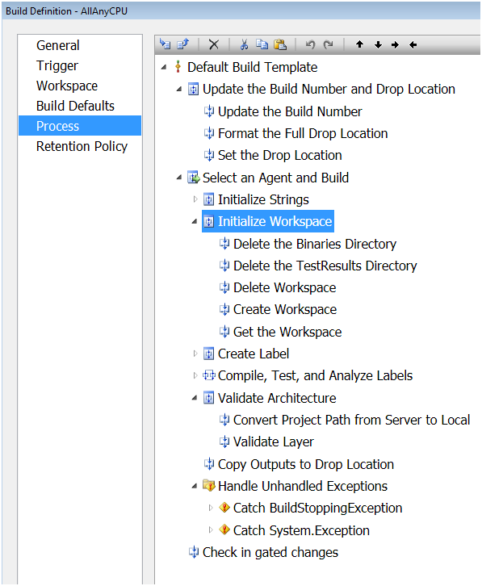
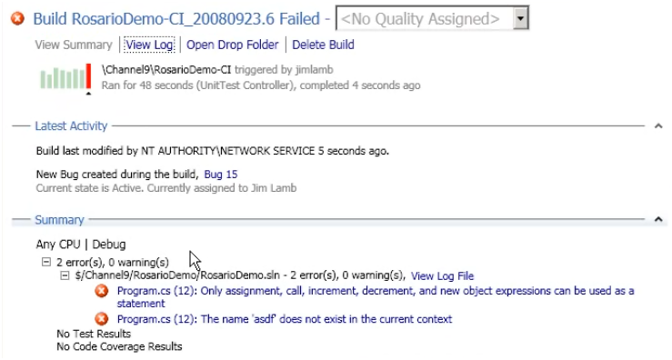
TFS Build Management
Rich Build Workflow, based on WF
Simpler but more informative build reports
Build Details View with links to errors/warnings

Slide 37
Build Workflow
Edit Code
Submit gated check-in
Automated Build
Ready for Test
Edit Code
Y / N
Notes:
Overview
When you’re building software as a team, there’s a natural cycle that you follow – testers find bugs, developers fix bugs, testers verify fixes. In order for this cycle to be productive, testers need builds that include fixes to the bugs that the developers have fixed. If the build is broken, there is a risk of holding up the entire team until it is fixed.
Gated check-in provides a way to prevent build breaks by validating a developer’s changes prior to committing them to the version control repository. Those changes are validated via an automated build. If the build fails, the user’s pending changes are rejected and passed back to them as a shelveset, otherwise the changes are committed to the repository.
Shelve-and-build, a related feature, lets the developer validate their changes with a private automated build. Unlike gated check-in, shelve-and-build is something the developer can choose to do. It can help identify breaks in code that the developer may not generally build on their local machine.
Value Proposition
If a single developer on your team typically breaks the build just once a year and you have 52 developers working on your project, the build could be broken every week. If you have 260 developers, the build could be broken every day. When the build breaks, the entire team may be stalled resulting in substantial productivity losses. Those losses could be prevented by the gated check-in feature.

Slide 38
Summary
VSTS 2010 is a major release.
CTP available now.
Best way to get started is to adopt VSTS 2008 now, upgrade to VSTS 2010 when it’s available.

Slide 39
More info
http://blogs.msdn.com/bharry/
http://channel9.msdn.com/visualstudio/
http://msdn.microsoft.com/en-us/vsts2008/products/bb725993.aspx

